Slide 1
Automated Data Extraction Solution Approach Note
End-to-End Data Extraction, Enrichment & Editorial Workflow Automation
For Real Deals Media
Version 1.0 28Oct2025

Slide 2
Introduction
About Real Deals Media
Real Deals Media (RDM) is a UK-based B2B intelligence publisher focused on private equity and M&A activity across Europe. Its editorial team curates deal insights for the Real Deals and Unquote platforms, serving investors, advisers, and analysts.
Bottlenecks Impacting Quality and Timeliness
The current workflow is predominantly manual, editor process around ~30-75 press releases and announcements daily, extracting and classifying deal details by hand. This results in a high editorial load, slower publication timelines, and inconsistencies in data structure and taxonomy, affecting overall coverage quality and speed to publish.

Slide 3




Data Extraction Workflow
Collect
Enrich
Check
Collect and parse content from identified web and email sources using ScrapeX and custom parsers.
Validate and enrich extracted records with secondary data from adviser sites, commercial databases, and manual editorial checks.
Apply automated validation rules for taxonomy, currency, and date formats, followed by editorial QA on sample records.
1
2
3
4
5
6
7
Discover
Process
Narrative Genration
Output
Identify and capture deal-related inputs from press releases, company sites, and email feeds
Apply parsing, semantic de-duplication, and LLM-based classifiers / filters (KIAA framework)
Generate automated deal summaries using extracted data, refined through advanced LLM models to align with Real Deals’ editorial tone.
Push structured data and generated narrative to SFTP for POC.

Slide 4

End-to-End AI-Enabled Deal Data Processing Workflow
Web & Document Collection
Validation & Taxonomy Alignment
Automatically capture deal announcements, press releases, and updates from company websites and emails (including attachments).
Support multiple formats such as .eml, .pdf, .docx, and .html.
Record key source metadata (URL, publication date, document type) for tracking and auditability.
Match extracted entities against Real Deals’ controlled vocabularies/picklist values for Sector, Sub-Sector, Region, and Deal Type.
Standardize numeric values, currency formats, and naming conventions.
Flag low-confidence data for editorial review and prevent duplicates through automated checks.
1
4
Content Parsing & Structuring
Summarisation & Content Generation
Extract readable text from varied file types using automated parsing tools.
Clean and organize content to remove non-informative sections like disclaimers, footers, and hyperlinks.
Segment text into logical sections (e.g., company background, deal rationale, financials) to improve AI accuracy.
Stage 1 - Auto Summary: Create a first-level summary by filling a predefined deal template using extracted fields.
Stage 2 - Editorial Summary: Refine the draft into a polished article that matches Real Deals’ editorial tone using advanced LLM models (GPT-4o / GPT-5).
2
5
AI-Powered Data Extraction
Integration & Publishing
Apply a Retrieval-Augmented Generation (RAG) pipeline aligned to a pre-defined schema.
Automatically identify and extract key entities (e.g., Target, Sponsor, Fund, Seller) and financial data (Deal Value, Turnover, Profit).
Generate structured JSON output with confidence scores for each extracted field.
Push validated structured data into SFTP in excel for POC
For full project into Azure SQL for long-term storage, analytics, and dashboards.
Automatically upload deal summaries into ExpressionEngine CMS as draft articles for editorial review and publication.
3
6

Slide 5
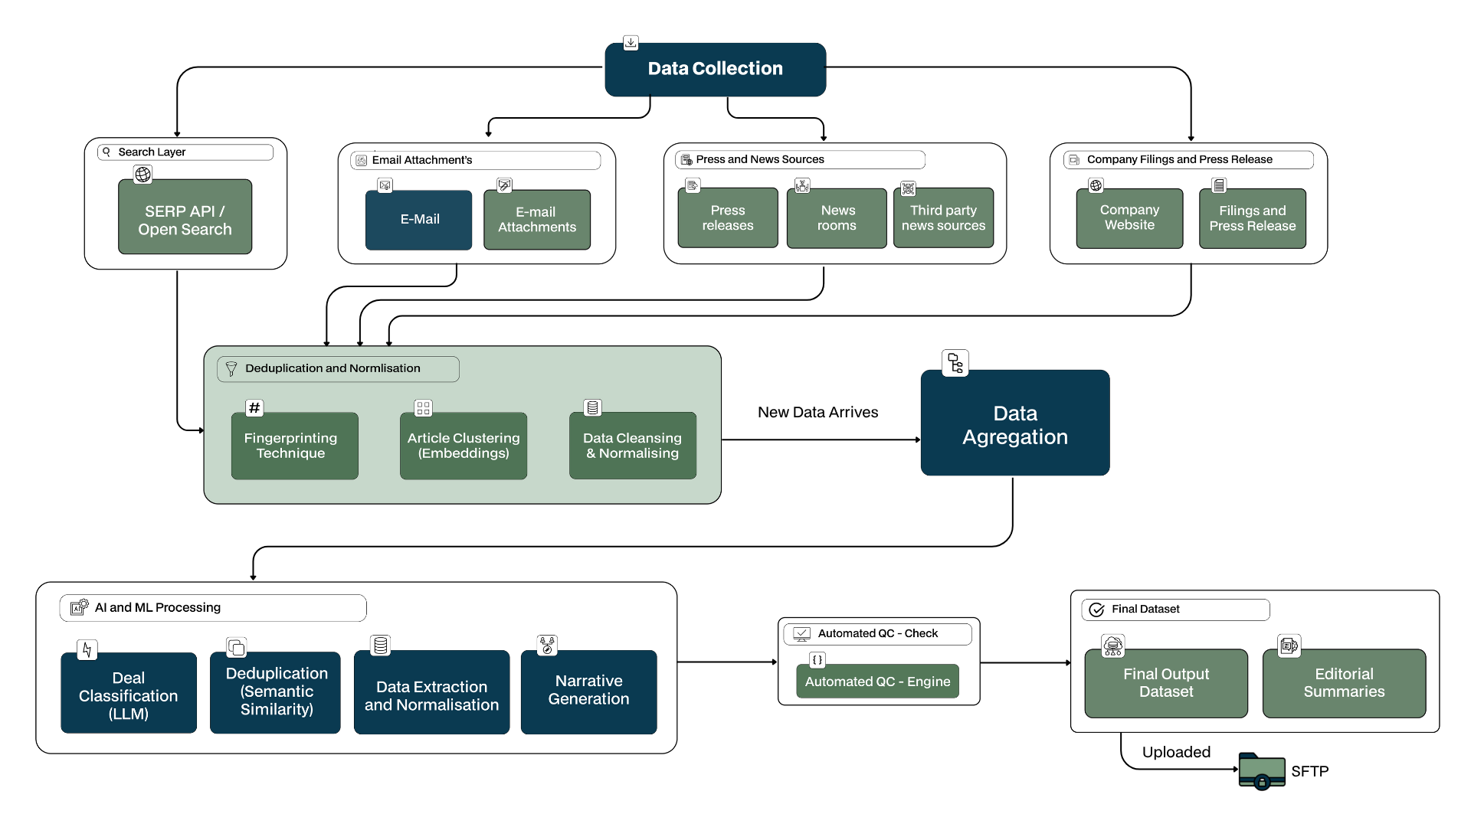
Detailed Data Extraction Workflow

Slide 6
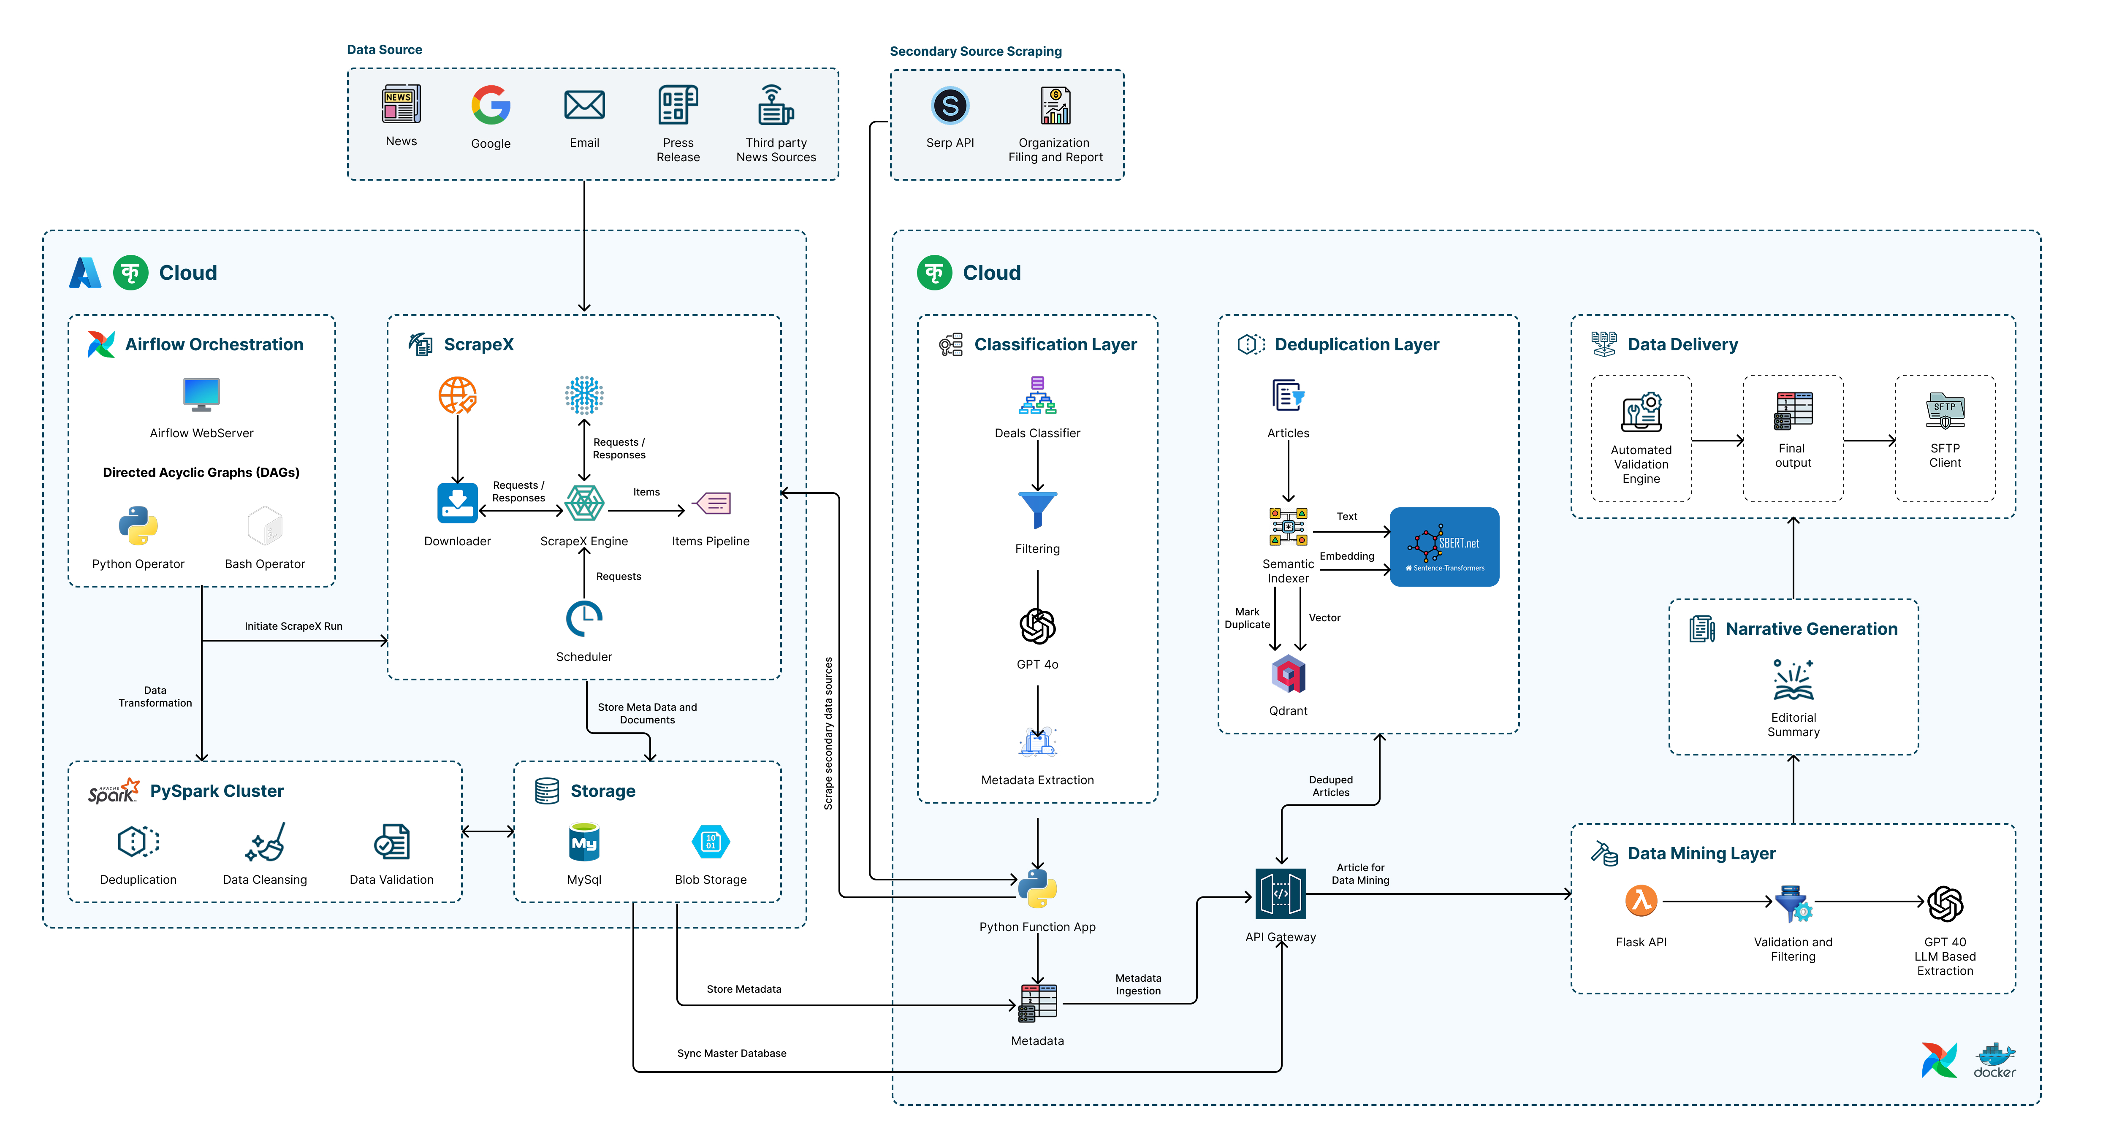
Technical Architecture Diagram
Note: ScrapeX and KIAA platforms are fully owned intellectual property (IP) of Merit Data and Tech Ltd.

Slide 7


POC Objectives
To perform a Proof of Concept (POC) on a selected set of sources of different complexities to demonstrate Merit’s capability to automate and streamline Real Deals Media’s (RDM) data extraction and editorial workflows enabling faster, more accurate, and scalable publishing of Private Equity and M&A deal intelligence.
Automates data extraction from structured and unstructured deal announcements, press releases, and company updates
Streamlines editorial workflows by converting raw content into structured deal records aligned with RDM’s taxonomy
Ensures accuracy and traceability through validation, deduplication, and confidence scoring for each extracted field
Reduces manual effort by leveraging AI-driven parsing and enrichment with human-in-the-loop verification
Delivers faster turnaround for publishing verified deal intelligence into RDM’s CMS
Demonstrates scalability of the solution across multiple regions, sectors, and deal types

Slide 8
POC Scope and Data Source Categories
Scope: Automated extraction and enrichment of Private Equity and M&A deal announcements across UK and European markets from selected online and email-based sources and generating narratives The project aims to replicate RDM’s editorial workflow by identifying, extracting, and structuring deal details including buyer, seller, advisers, deal value, sector, and geography and delivering the enriched dataset.
POC Input
Search & Discovery Methods: SERP API (Google/Bing), OpenSearch (up to 10 pages)
Web Sources : 3 identified web sources of varied complexities (To be discussed and agreed with RDM)
Email & PDF Ingestion: Parsing of 1 deal-related press releases and announcements from editorial inboxes.(gmail or Outlook considered)
Taxonomy Mapping and Narrative Generation:
Map extracted data to RDM’s controlled taxonomy and auto-generate deal narratives aligned with editorial tone and style.
Data Points : List of Data Points updated in Appendix II.
Output :
POC Output will be shared in excel to SFTP
Maintain an audit log of processed documents, extracted data, and system confidence levels
Out Of Scope:
Advanced deal types and complex field mappings that require new rule-building or logic creation will be considered out of scope for this POC and may be addressed in future phases in collaboration with RDM.
Push validated structured data into Azure SQL for long-term storage, analytics, and dashboards.
Automatically upload deal summaries into ExpressionEngine CMS as draft articles for editorial review and publication

Slide 9
POC Steps and Estimates
Description | Cost
Discovery, Analysis and Planning | FOC
Solution Design and System Set up
ScrapeX configuration – c40 sources
AI/ML solution using KIAA framework - classifier, semantic de-duping, data mining
Solution Testing /QA (Tech)
Data Transformation, Logging, Alerts, Reports and Delivery
Solution Integration and Deployment
Documentation
Project Management
Total Solution Set Up / Configuration Costs For POC | FOC
Note:
The POC will be carried out Free of Cost for the scope mentioned in Slide 8 (POC Scope and Data Source Categories)

Slide 10
POC Key Milestones and Projected Timelines
Milestones | Estimated Duration | Planned Start Date | Planned End Date
POC Milestones and Timelines
POC Solution Configuration | 4 Weeks | 17-Nov-25 | 15-Dec-25
POC UAT (output checks by RDM) | 2 Weeks | 16-Dec-25 | 31-Dec-25
POC UAT Issue Fixes | 1 Week | 5-Jan-26 | 12-Jan-26

Slide 11
Scope and Data Source Categories For Full Phase
Input
Search & Discovery Methods: SERP API (Google/Bing), OpenSearch (up to 10 pages)
Web Sources : 40 identified web sources (To be updated by RDM in Appendix 1)
Email & PDF Ingestion: Parsing of deal-related press releases and announcements from editorial inboxes.(gmail and Outlook considered)
Taxonomy Mapping and Narrative Generation : Map extracted data to RDM’s controlled taxonomy and auto-generate deal narratives aligned with editorial tone and style.
Data Points : List of Data Points updated in Appendix II.
Output :
Push validated structured data into Azure SQL for long-term storage, analytics, and dashboards.
Automatically upload deal summaries into ExpressionEngine CMS as draft articles for editorial review and publication.
Maintain an audit log of processed documents, extracted data, and system confidence levels

Slide 12
Estimated Full Project Costs – High Level
Description | Cost | Comments
Discovery, Analysis and Planning | FOC | Covered in POC
Solution Design and System Set up | £3,475
ScrapeX configuration – c40 sources | £2,376
AI/ML solution using KIAA framework - classifier, semantic de-duping, data mining | £9,415
Solution Testing /QA (Tech) | £3,879
Data Transformation, Logging, Alerts, Reports and Delivery | £704
Solution Integration and Deployment | £4,022
Documentation | FOC
Project Management | FOC
Total Solution Set Up / Configuration Costs | £23,870
Buffer For Contingencies | £2,007
Total Infra Costs | £890 | Covered in Appendix III
Total Cost of Solution Customisation / Configuration | £26,767
Notes
The costs are only indicative and based on detailed analysis and better understanding the estimates might vary
Any alteration or expansion of the project's scope will also have an effect on the estimates provided above. Any additional sources will be analysed and estimated based on complexity.
Infrastructure costs are estimates and will be billed on actuals

Slide 13
Estimated Recurring BAU Costs (Monthly) – High Level
MONTHLY RECURRING COST – BAU (For Current Volume)
S.No. | Item Description | Total Cost
I. | Support and Maintenance (Tech Resources – AI/ML Solution Maintenance) (0.15 FTE) | £450
II. | Support and Maintenance (Tech Resources - Scraper Maintenance) (0.25 FTE) | £750
III. | Infrastructure (Will be billed on actuals) | £815
TOTAL COST |  | £2,015
INFRASTRUCTURE COST BREAKUP
S.No. | Item Description | Total Cost
I | Proxy Services | £60
II | Virtual Machine(Ubuntu) (For Scraping) | £100
III | DataBase | £275
IV | Storage | £20
V | Backup | £20
VI | Serper(Open Search) | £60
VII | Overall token costs per month ** | £110
VIII | Virtual Machine(Ubuntu) - AMD EPYC 9554 - CPU-8x-32GB (For AI) | £170
Total Estimated Infra Cost |  | £815
Note:
**Average token cost per document (based on current OpenAI pricing and the sample documents reviewed) has been estimated by alternating the use of GPT-4o, GPT-o3, and GPT-4o-mini models depending on the response type and complexity. The projected monthly cost assumes a processing volume of approximately 40 documents per day over 25 working days, totalling 1,000 documents per month
Costs will be impacted if requirements or agreed volume changes. Infrastructure costs are estimates and will be billed on actuals.
The estimates are considering that the solution will be hosted on Merit's on-prem servers.
Regular monthly Support and Maintenance will be charged as mentioned above. Any changes to the requirement will be communicated and any changes mutually agreed by both parties will be billed on actual effort spent @ £30 per hour

Slide 14
Key Milestones and Projected Timelines
Milestones | Estimated Duration | Planned Start Date | Planned End Date
Full Project Milestones and Timelines
Final Proposal Discussion Cost Finalisation and Contracts Setup | 4 Weeks | 13-Jan-26 | 06-Feb-26
Full Project Solution Customisation / Configuration | 8 Weeks | 09-Feb-26 | 07-Apr-26
UAT (output checks by RDM) | 2 Weeks | 08-Apr-26 | 22-Apr-26
UAT Feedback Fixes and Deployment | 1 Week | 23-Apr-26 | 30-Apr-26
BAU Commencement
BAU Start date | Ongoing Monthly | 01 May 26

Slide 15
Assumptions
The current estimation covers 40 identified sources, subject to confirmation and finalisation with RDM
The estimations are based on the assumption that deal data will be sourced from publicly available deal announcements, press releases, and updates from company websites and email subscriptions in scope.
No paywalled or restricted sources are included within the current scope.
Data collection will also leverage email subscriptions and notifications received from editorial inboxes. (gmail and outlook considered)
Open Search (Google OpenSearch) will be limited to the first 10 result pages to identify relevant base articles or leads.
Organisation level details will be extracted where available in web search, including Trade or Registered Company Name, Turnover/Revenue (Profit), Sector, and Deal Region.

Slide 16
Benefits
A dedicated Project Manager and Business Analyst will be assigned to oversee the engagement at no additional cost, ensuring smooth delivery and stakeholder alignment throughout the project duration.
Documentation efforts are also included Free of Cost, in recognition of the long-term partnership Merit anticipates building through this engagement.
By leveraging our proprietary accelerator platforms ScrapeX for scraping and KIAA for AI/ML workflows. Merit has achieved significant cost efficiencies across key solution components:
A) ~40% reduction in scraper customisation costs through reusable ScrapeX modules and configuration-based development.
B) ~35% reduction in AI/ML solution development costs through pre-trained models, reusable pipelines, and scalable infrastructure under the KIAA framework.
Also the estimated development timeline reduced from 2.5 months to 1.5 months, enabled by pre-built modules, automation utilities, and optimised data processing workflows.
Note: Infrastructure costs indicated are provisional estimates and will be billed based on actual usage during implementation.

Slide 17
Appendix I (List of Sources)
Sources to be updated by RDM

Slide 18
Appendix II – Data Points
From RDM Data Sample​
From Screenshots Shared
Merit Suggested Fields for Deals Data
Lenders
Target
Sponsor(s)
Fund(s)
Estimated?
Deal date
Seller name
Seller type
Basic deal type
Advanced deal type
DealValueMillion
EuroConversion
Deal value (EURm)
Value range (EURm)
Currency
Turnover (m)
Profit (m)
Country
European region
UK region
Corporate finance (sell-side)
Corporate finance (all)
Legal
Financial/Tax DD
Commercial DD
Other DD
Sector
Sub-sector
Holding Period / Investment Duration
Fund size category
Region (derived)
Exit Rationale / Realisation Notes
Debt Adviser / Financing Source
Deal size bucket (derived)
Target Description
Founded Year
Headquarters City
Article Type
Author / Contributor
Publish Date
Headline Style Variant
Oil & Gas
Industrials & Basic Materials
Utilities
Consumer Goods & Services
Business Services
Healthcare
Financials
Telecommunications
Technology
Energy & Environment
Confidence score
Extraction source
Full/Partial
Deal Nature / Context
Transaction Role
Buyer Type
Turnover source
Profit type
Profit source
Employee Count
Customer Count / Reach
Article Title
Article Excerpt
Article Body
Article Tags
Categories
Rationale / Growth Objective
Post-deal Plans
Board / Leadership Changes
Merit Suggested Fields for Narrative

Slide 19
Appendix III – Infrastructure Details During Setup
S.No | Infrastructure Used During POC | Comments
1 | Proxy Services | Region specific proxies
2 | Virtual Machines(Ubuntu) | B4as v2: 4 vCPUs, 16 GB RAM, 0 GB Temporary storage, £0.127/hour
3 | DB Server | D Series, 4 vCore, £0.2955/hour
4 | Storage
5 | Backup
6 | Serper(Open Search) API
7 | Open AI Key

